Slide 1




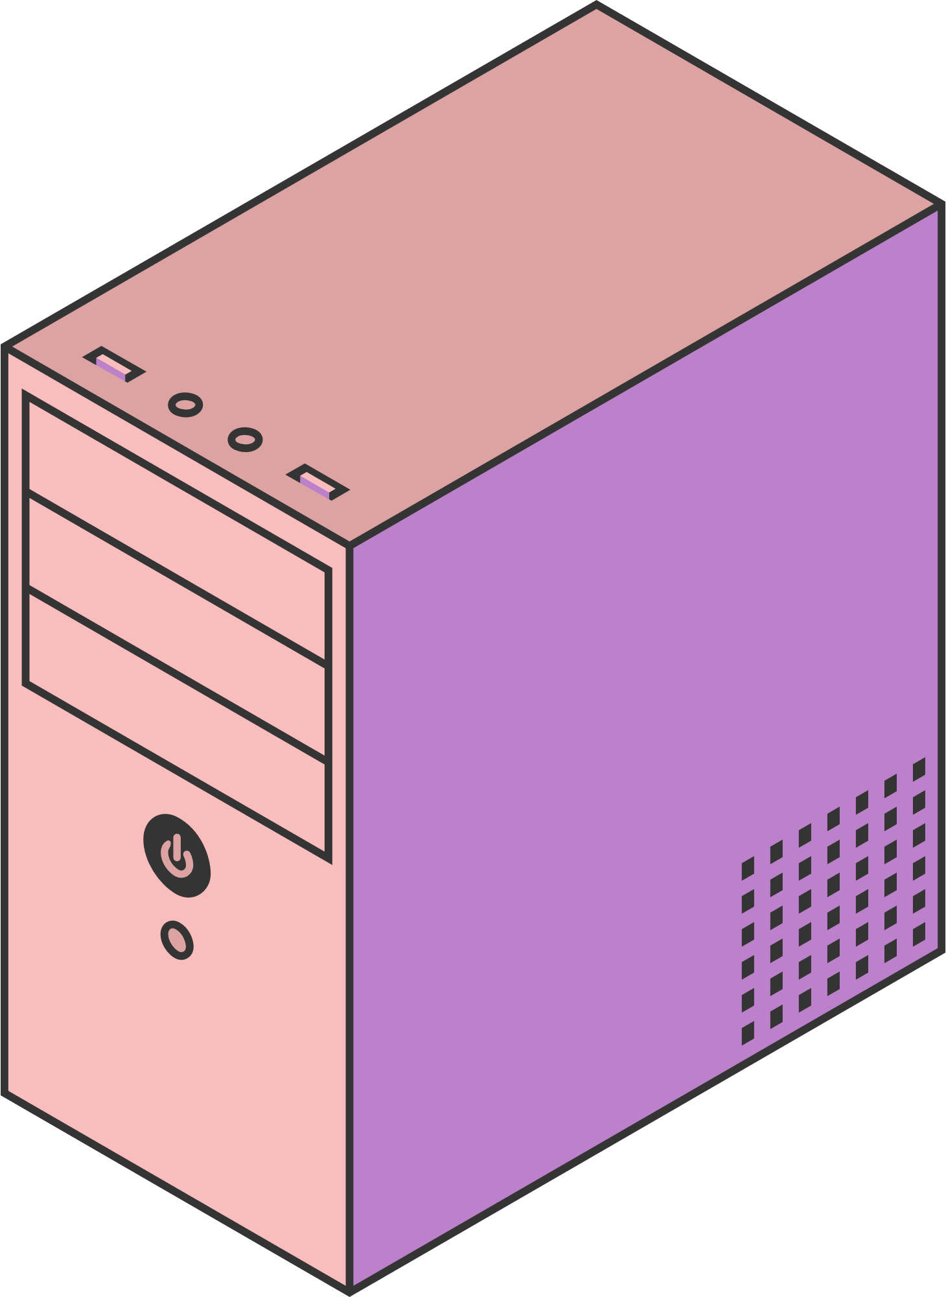
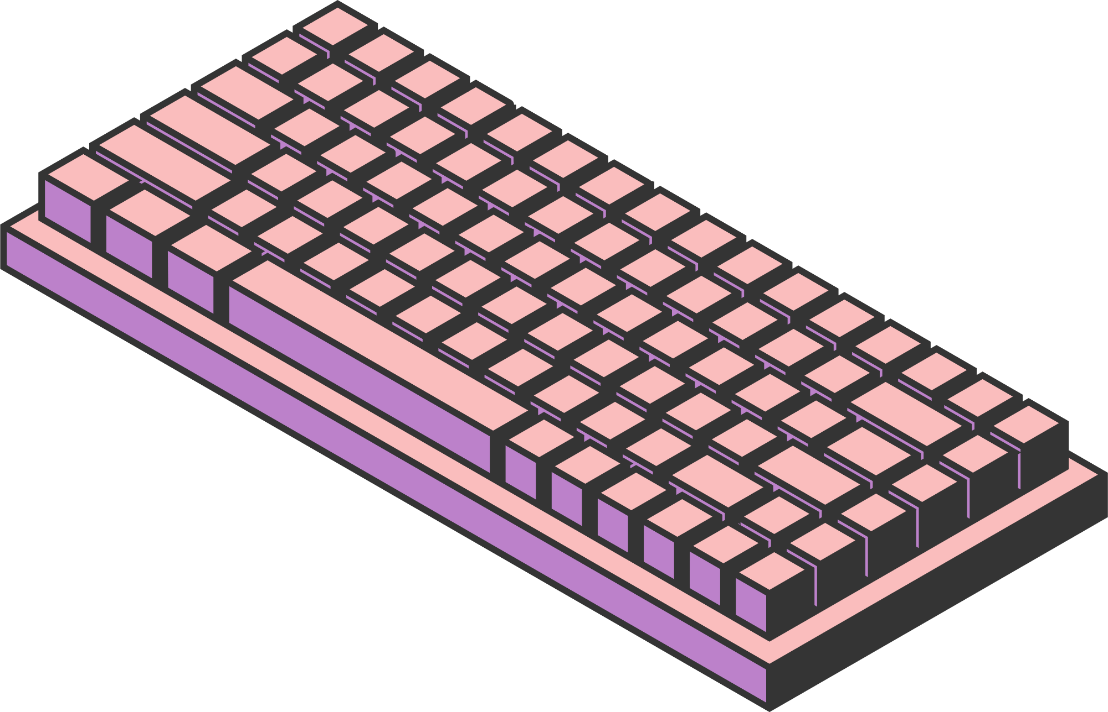
5leha 3la Allah
VIRTUAL MEETINGS
SYSTEM
Abdulrahman Gomaa 23-101279
Abdelrahman Essmat 23-101348
Ahmed Khairy 23-101243
Seif Haytham 23-101282
Maryam Rageh 23-101297
Page 01

Slide 2





TABLE OF CONTENT
Brief Description of the System
Explanation of the Classes Implemented in the Project
Database Integration
User Manual
Contribution Sheet & References
Page 02

Slide 3


What if managing virtual events
could be simple, secure, and scalable?
Page 03

Slide 4

INTRODUCTION |
Our Event Management System is a C++-based application designed to streamline the organization and participation of virtual events through a secure and intuitive interface. The system provides a structured user experience, backed by maintainable class hierarchies and dynamic data handling, making it both scalable and efficient for future enhancements.
Page 04

Slide 5
INTRODUCTION ||
Once authenticated, users can create events, specifying key details such as title, description, date, and time. As event organizers, they can manage these events further by postponing or cancelling them when necessary. Participants, on the other hand, can view all available events, register for the ones they’re interested in, and even track the events they’ve signed up for. A waiting list system ensures fair access when events reach capacity, and many more other features.
Page 05

Slide 6
INTRODUCTION |||
The user interface is built with clarity and simplicity in mind. Menus are easy to navigate, choices are validated to prevent incorrect input, and all operations are confirmed with feedback messages. The system’s backend utilizes C++ classes to encapsulate event data, user profiles, and registration details, enabling better data management and cleaner code organization.
This modular, user-friendly platform is ideal for universities, clubs, or any small-to-medium group looking for an efficient way to handle virtual event logistics.
Page 06

Slide 7
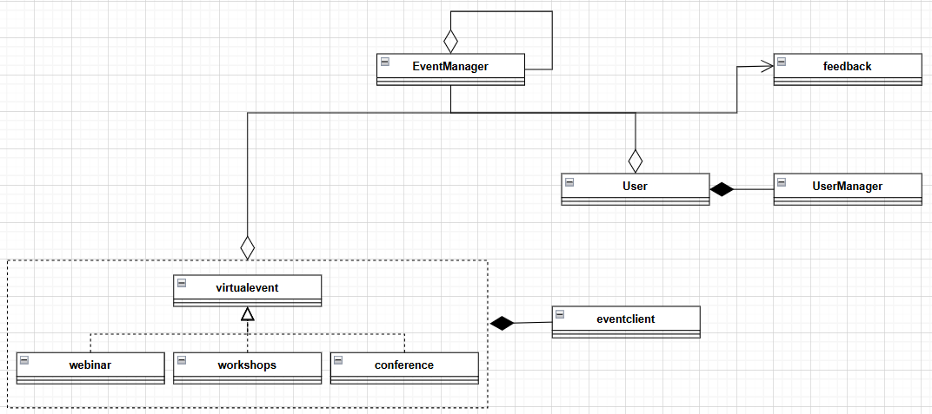
UML DESIGN
Page 07

Slide 8


How does our system manage users, events, and registrations so efficiently?
Page 08

Slide 9
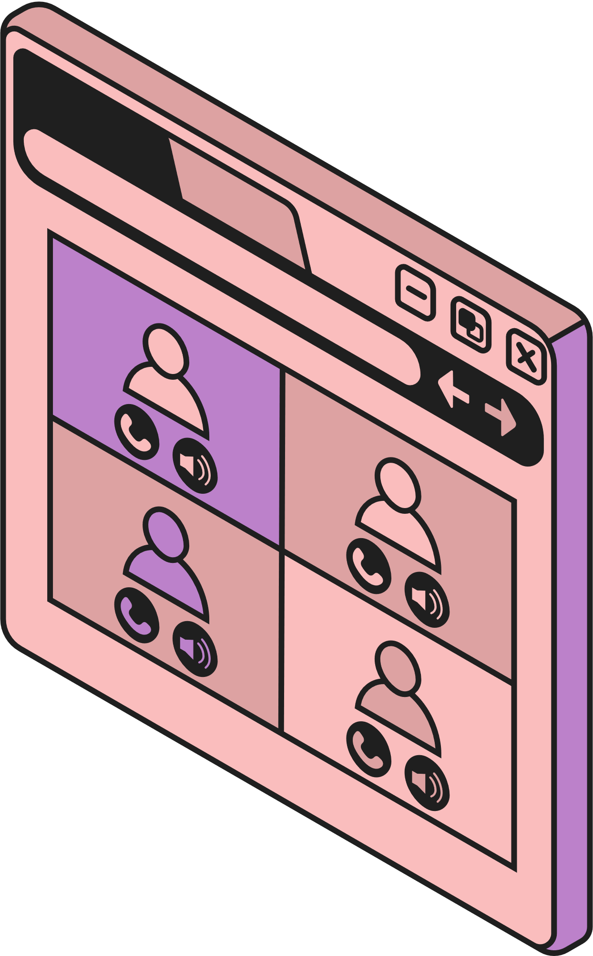
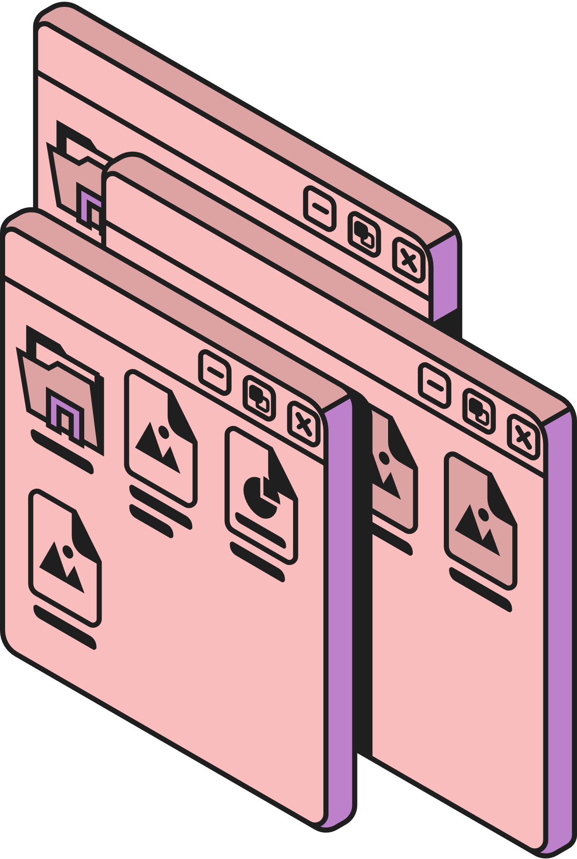
USER & USER MANAGER
User Class:
- Stores user profile information (name, email, affiliation)
- Tracks created and registered events
- Manages event registration/cancellation
- Handles user authentication
UserManager Class:
- Maintains system user database
- Provides login/signup functionality
- Loads user data from SQLite database
- Validates user credentials
Security Features:
- Password protection
- Email-based authentication
- Encap- Secure session management
sulated user data
Page 10

Slide 10
VIRTUAL EVENT FACTORY
Factory Design Pattern Implementation:
- Creates different event types (Workshop/Webinar/Conference)
- Encapsulates object creation logic
- Provides flexible event instantiation
EventClient Class:
- Interface for event creation
- Delegates to appropriate event subclass
- Manages event lifecycle
Benefits:
- Clean separation of concerns
- Easy addition of new event types
- Polymorphic event handling
- Simplified client code
Page 11

Slide 11
EVENT MANAGER
Core class that manages all system operations using Singleton pattern:
- Centralized control of all virtual events
- Maintains collection of events (Workshops, Webinars, Conferences)
- Implements user-event interactions
Key Features:
- Singleton design ensures single instance
- Manages event lifecycle (create/modify/cancel)
- Handles attendee registration/waitlisting
- Processes event feedback and ratings
- Provides Dynamic search functionality by:
- Event name
- Date
- Organizer
- Type
- Any Filter
Database Integration:
- Loads events from SQLite database
- Synchronizes attendee lists
- Updates event changes in real-time
Page 09

Slide 12
FEEDBACK
Feedback Class Features:
- Stores ratings (1-5 scale) and comments
- Tracks submission date and user/event IDs
- Integrates with database for persistence
System Capabilities:
- Calculate event average ratings
- Store and retrieve user feedback
- Validate feedback submissions
- Display feedback summaries
User Benefits:
- Share event experiences
- Help improve future events
- View others' feedback when choosing events
Page 12

Slide 13


What if the system could AUTOMATICALLY save your spot when someone cancels?
No more manual refreshes. No missed opportunities.
Here's how we solved it...
Page 12

Slide 14
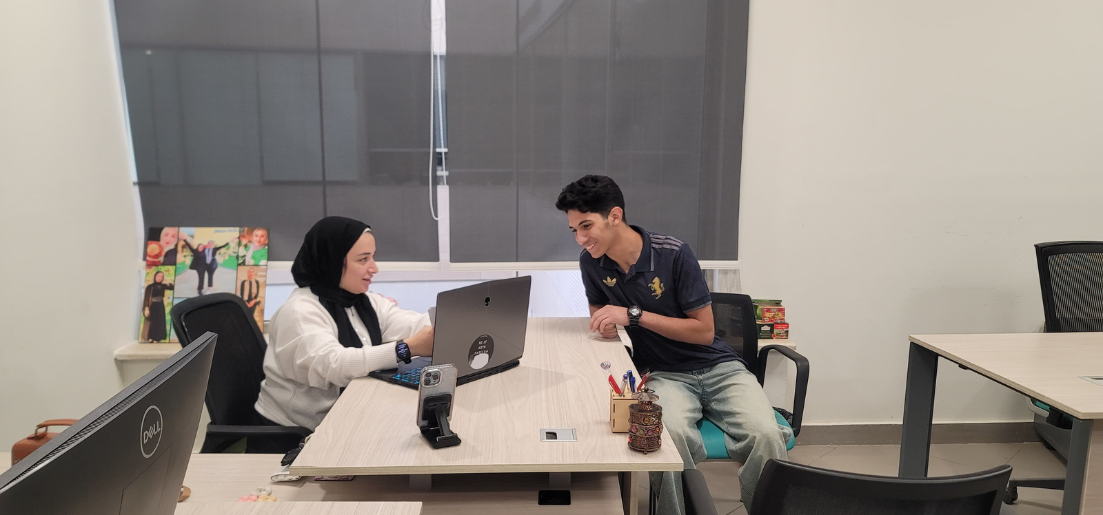
Seif: Dr. Shaymaa, can I register for your office hours?
Dr. Shaymaa: Yes! You’re now registered.
Page 12

Slide 15
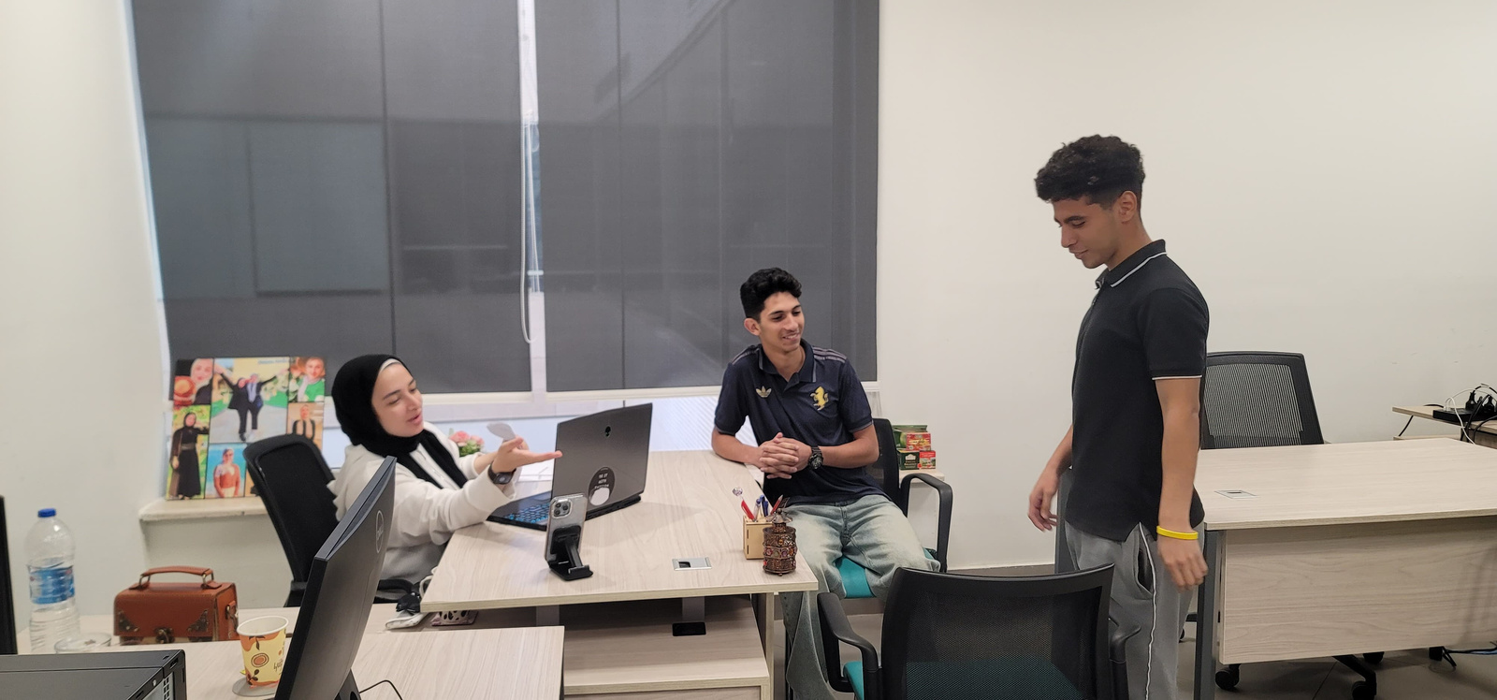
Essmat: I’d like to register too.
Dr. Shaymaa: Approved.
Page 12

Slide 16
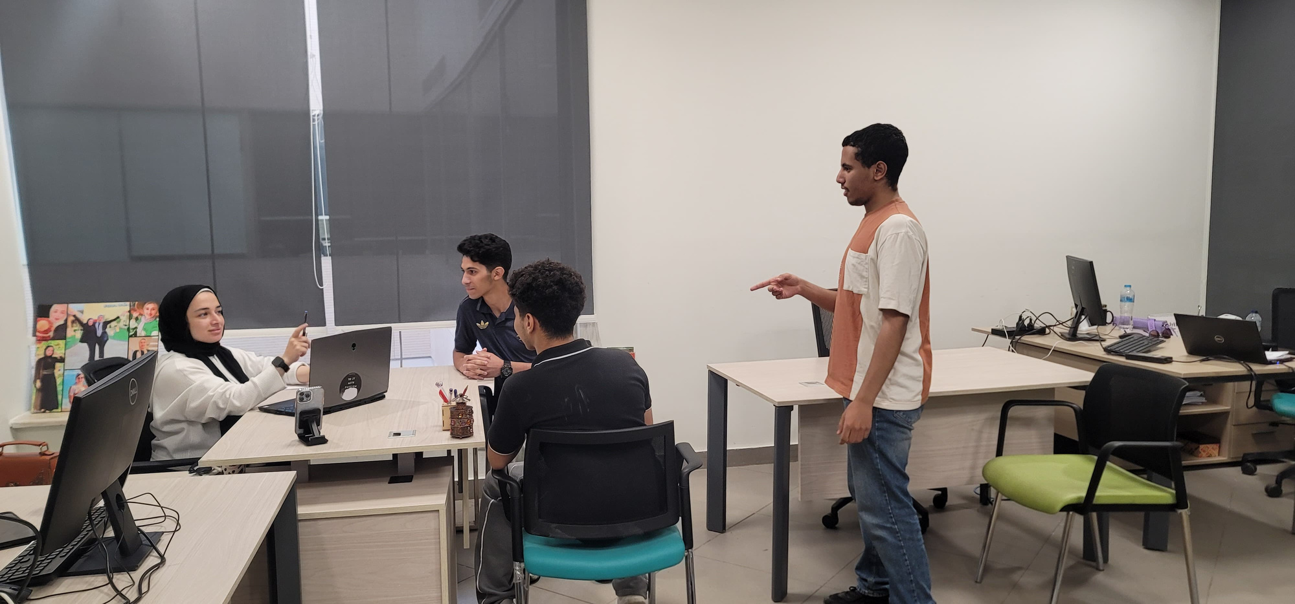
Gomaa: Can I register?
Dr Shaymaa: No , Join the waiting list?
Page 12

Slide 17
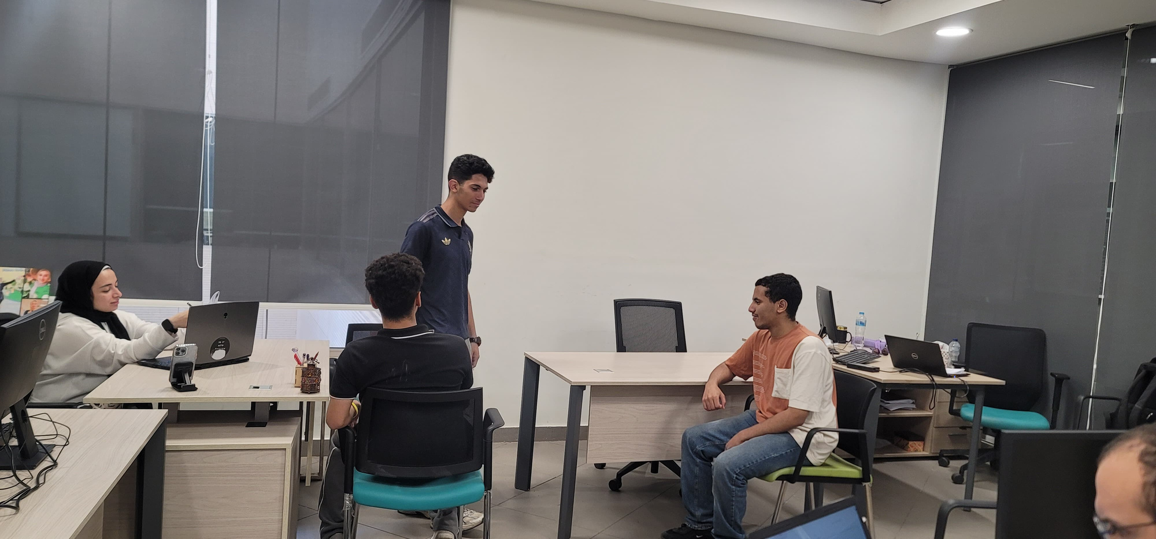
Seif cancels (slot opens).
Dr Shaymaa : Gomaa, a slot is available.
Page 12

Slide 18
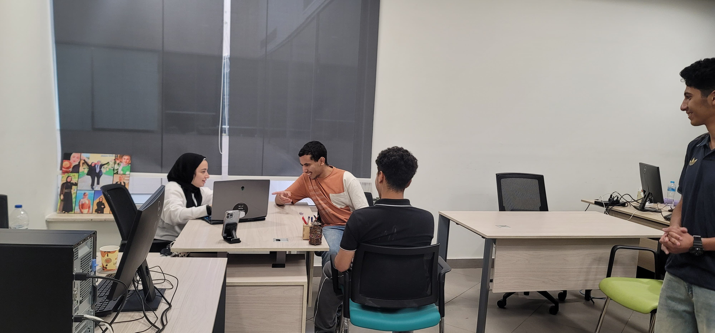

Now registered!
Page 12

Slide 19

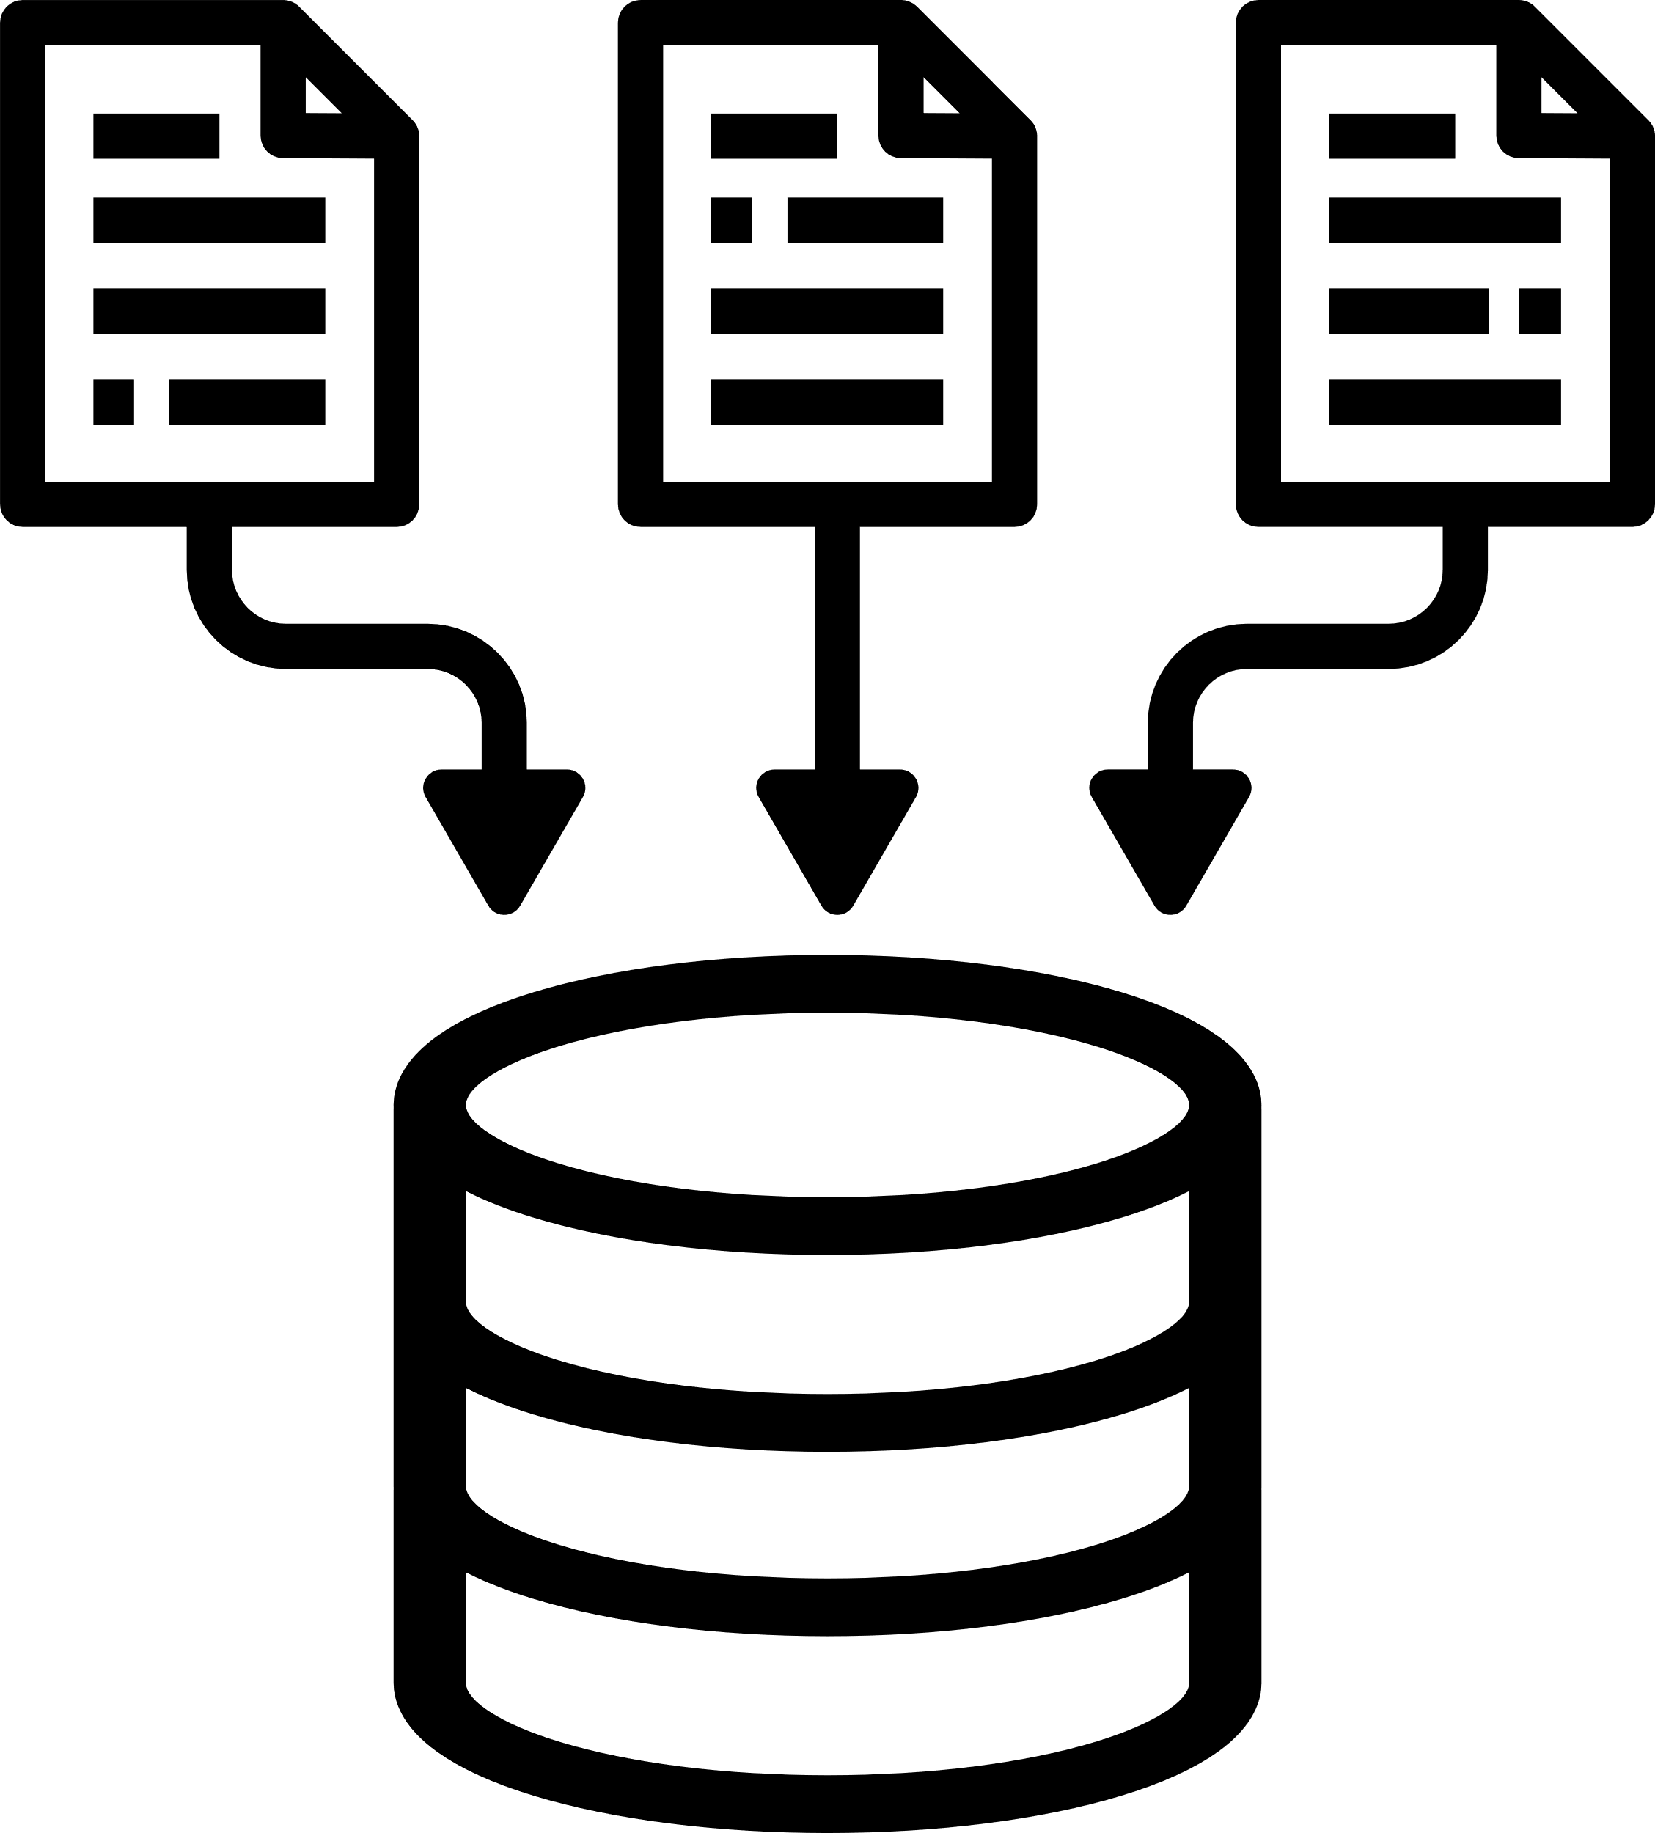
Where does all the event and user data go?
How do we keep it organized?
Page 13

Slide 20



DATA
MANAGEMENT
DATABASE LIBRARY
KEY DATABASE FUNCTIONALITIES
DATABASE OVERVIEW
Page 14

Slide 21

SQLite3 Library
SQLite is the most used database engine in the world
SQLite is a C-language library that implements a small, fast, self-contained,
high-reliability, full-featured, SQL database engine
Merits
Lightweight, embedded SQL database engine
Stores data in a single file (VMS1.sqlite)
Supports SQL queries and transactions
Easy integration with C++ via SQLite3 API
Page 15

Slide 22
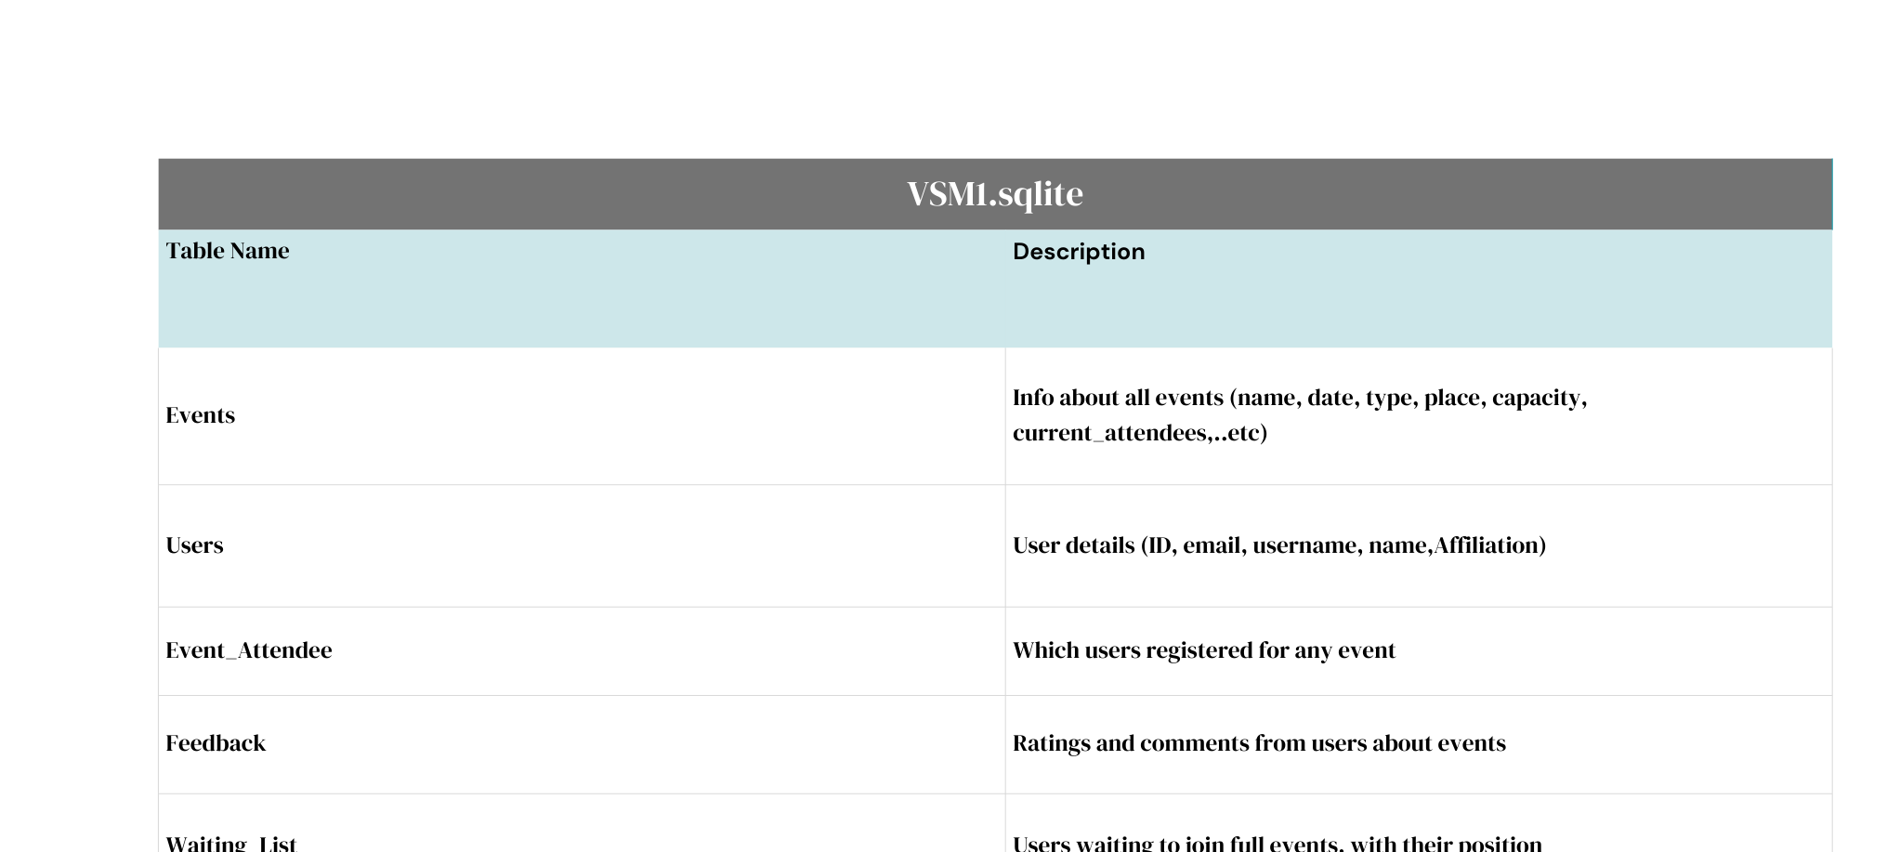
OVERVIEW OF DATABASE ENTITIES
Page 16

Slide 23

KEY DATABASE
FUNCTIONALITIES
Page 17

Slide 24

KEY DATABASE
FUNCTIONALITIES
Event Management: Add, update, delete events, with checks to avoid duplicates
User Management: Add users, authenticate login, delete users
Registration: Register and unregister attendees for events
Waiting List: Manage waiting list for full events with position updates
Feedback System: Submit, retrieve, and delete feedback for events
Search & Filter: Dynamic multi-criteria search for events (by name, date, capacity, platform, organizer)
Page 18

Slide 25
USER MANUAL
Page 19

Slide 26
Steps To Run our Program
Download CLion and set it up on your computer
Open CLion
Open the main.cpp from CLion and it will automatically load up the rest of the files
Build and run the program
If it’s your first time to use the program, Signup to create a new account.
If you’ve already created an account, just Login with your username and password
Once you’re in, get ready to enjoy the high class features in our Virtual Meetings System
Page 20

Slide 27
Key Features of the Event Management System
Personalized Experience
Displays a personalized welcome message for the logged-in user.
Event Creation & Management
Create New Event: Add events with title, description, date, and time.
Manage My Events: Postpone, cancel, or update events you've created.
Event Participation
View Registered Events: Easily track events you've signed up for.
Browse All Events: Explore all available public events in the system.
Waiting List System: Automatically queue users when an event is full.
Account Management
Account Settings: Edit user profile, change password, or manage preferences.
Secure Access
Logout Option: Ensures session safety and user privacy.
Page 21

Slide 28
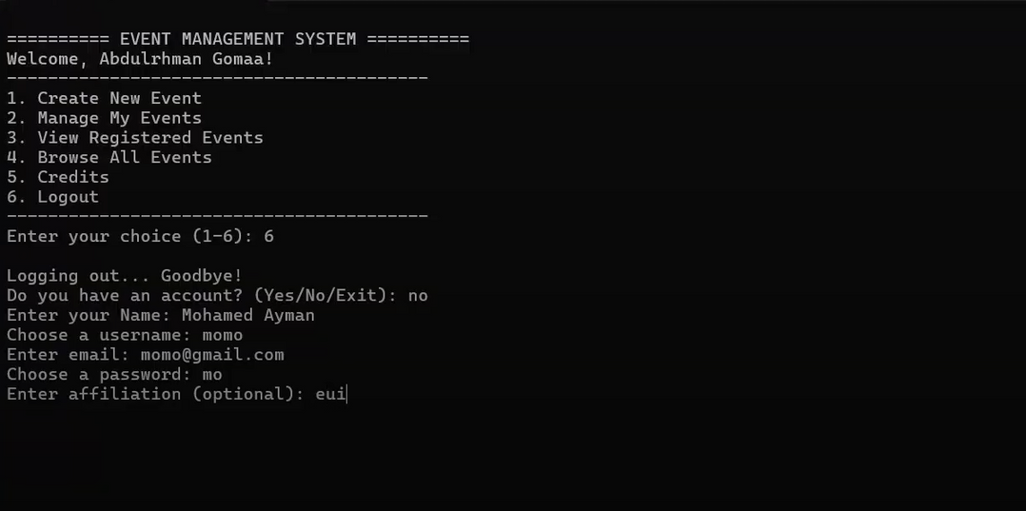
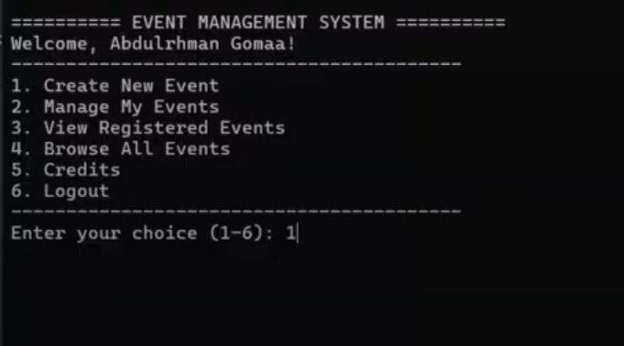
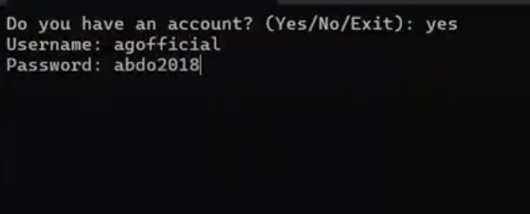
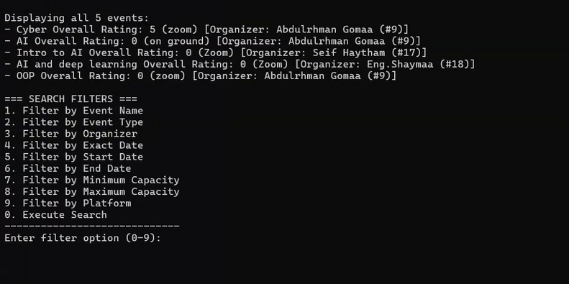
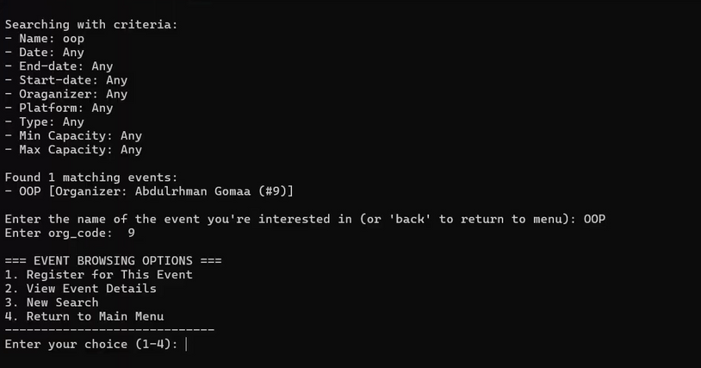
SOME SCREENSHOTS FROM THE TERMINAL
Page 22

Slide 29


Behind every powerful system is a simple interface that brings it to life.
Page 23

Slide 30
GRAPHICAL USER
INTERFACE (GUI)
Page 23

Slide 31
Key Features of the GUI version
Creating Events with a friendly user interface
Viewing all the events on a table with the ability to see full details about them with double clicking
Displaying schedule for the events
Page 21

Slide 32
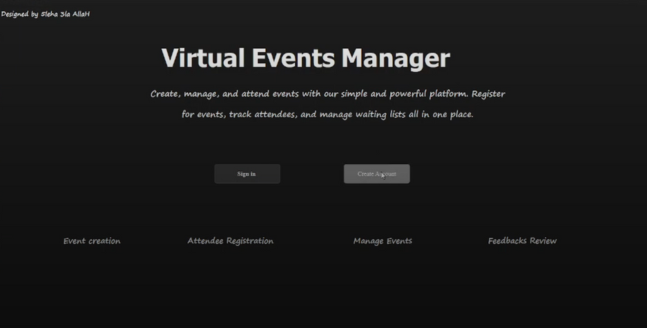
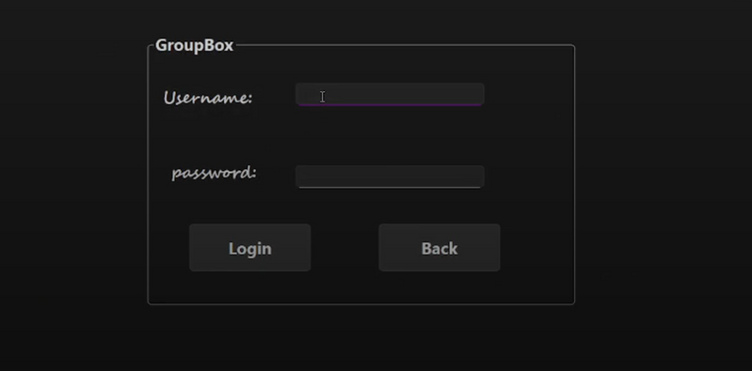
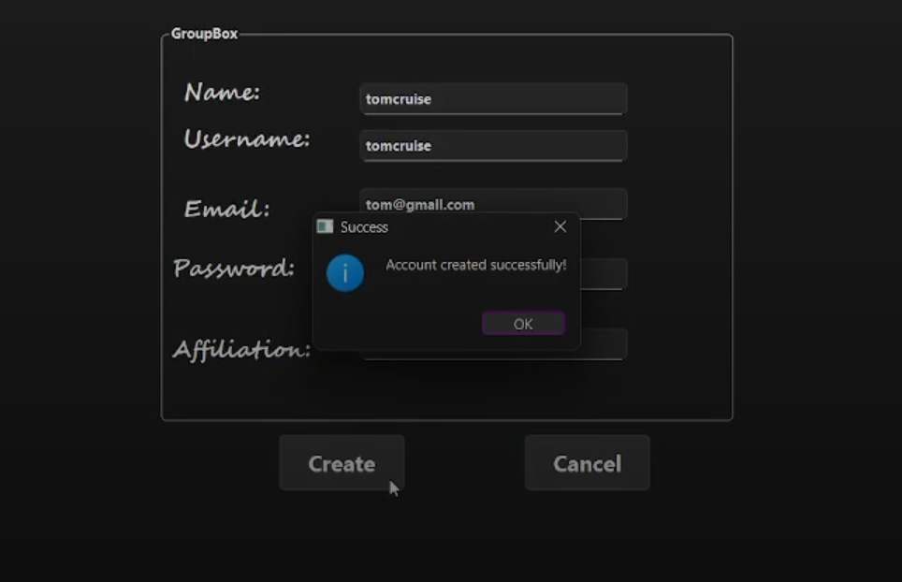
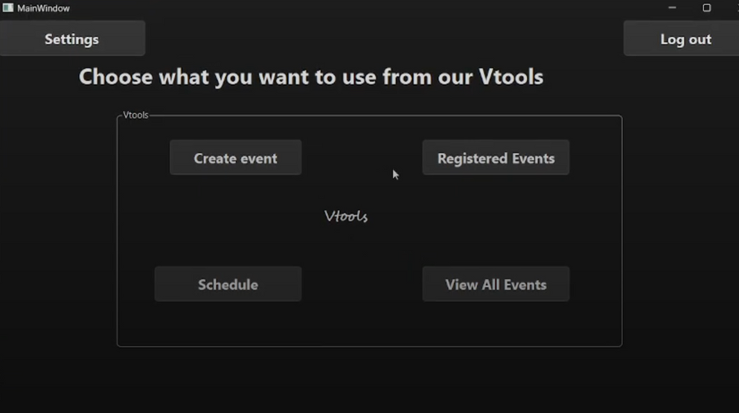
SOME SCREENSHOTS FROM THE APP
Page 22

Slide 33
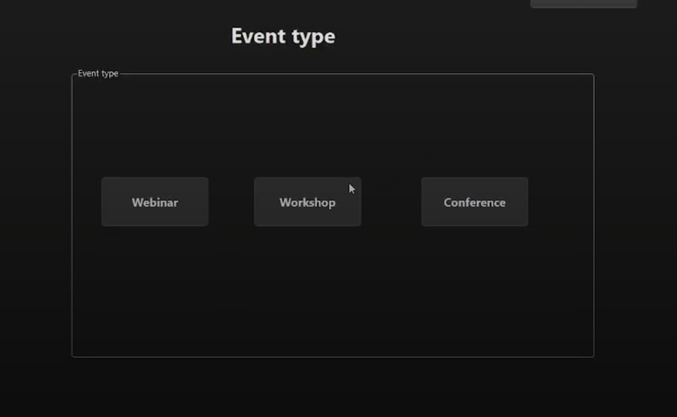
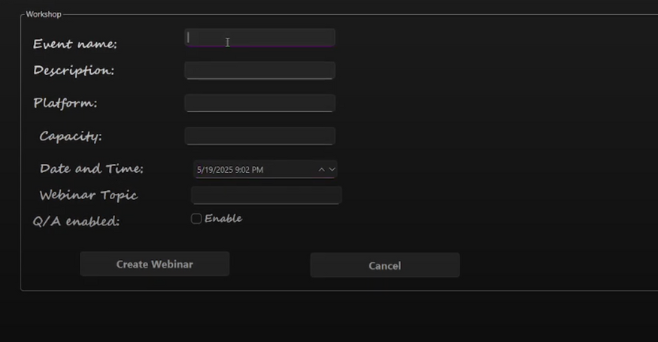
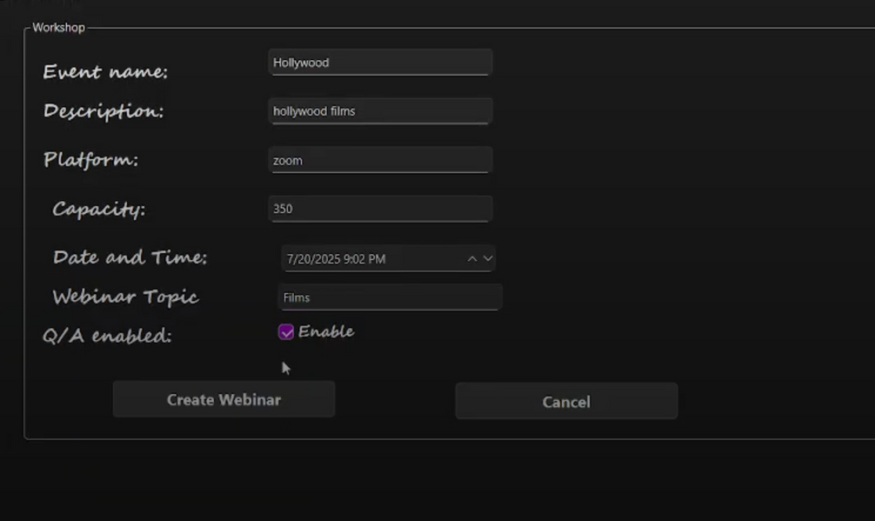
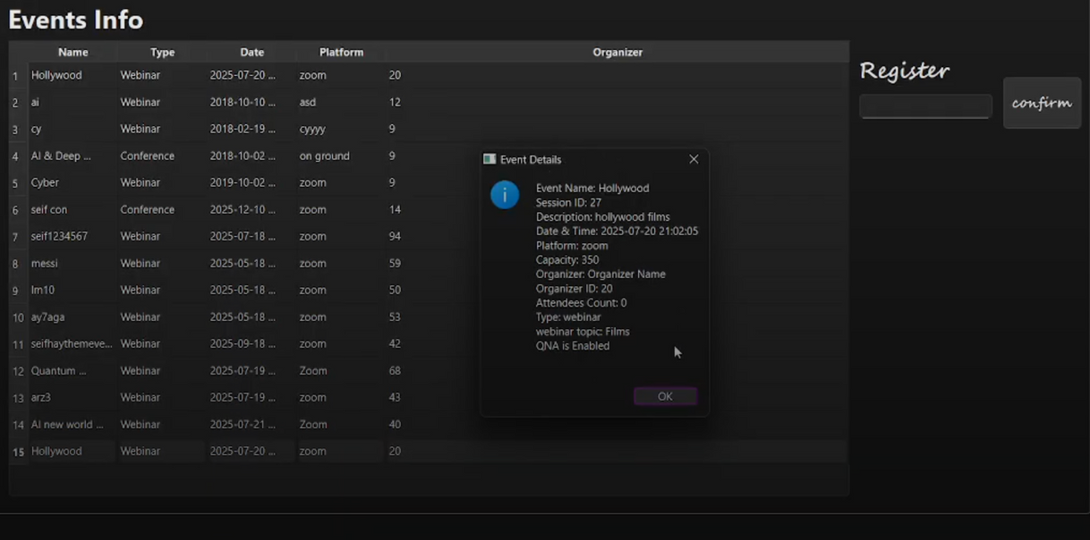
SOME SCREENSHOTS FROM THE APP
Page 23

Slide 34



COLLABORATION SHEET
Seif Haytham | Event Creation Dynamic Search GUI version
Abdelrahman Essmat | Event manager Attendee Registration waiting list presentation
Ahmed Khairy | Event Creation Attendee Registration poster
Abdulrahman Gomaa | Code Integeration Database poster
Maryam Rageh | User and User Manager Feedback Presentation
Page 09

Slide 35




THANK YOU
Page 10

